Slide 1
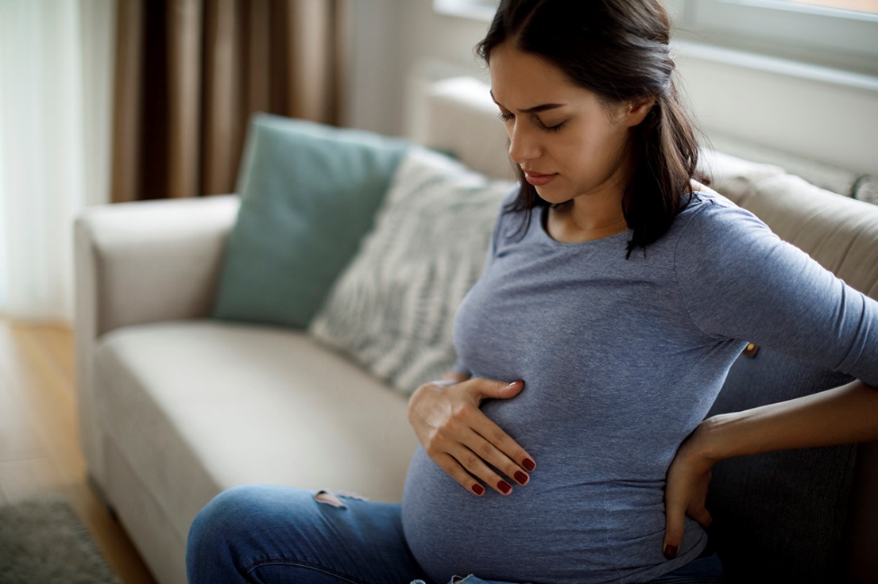
Pregnancy-Related Mortality in CA
CA-PMSS, 2011-2019

Slide 2
Instructions
You are welcome to use any of the slides provided for educational purposes.
Suggested citation:
CA-PMSS: Pregnancy-Related Mortality in California, 2011-2019. California Department of Public Health; Maternal, Child and Adolescent Health Division. 2022. www.cdph.ca.gov/ca-pmss
Questions? Contact us at MCAHDataHelp@cdph.ca.gov

Slide 3
Pregnancy-Related Mortality Ratio in U.S. and California 2011-2019
Pregnancy-related mortality ratio (PRMR) = Number of pregnancy-related deaths per 100,000 live births, up to one year after the end of pregnancy. Pregnancy-relatedness determinations were made through a structured expert committee case review process. Data on U.S. PRMR are published by CDC Pregnancy Mortality Surveillance System (accessed at Pregnancy Mortality Surveillance System | Maternal and Infant Health | CDC on January 19, 2022).
Notes:
Alt Text:
This figure shows the pregnancy-related mortality ratio in the U.S. and California from 2011 through 2019.
California’s pregnancy-related mortality ratio was consistently lower than the U.S. PRMR from 2011 through 2017 (the latest available data for U.S.).
In 2019, California’s pregnancy-related mortality ratio was 12.8 deaths per 100,000 live births. It was lower than the pregnancy-related mortality ratio of 16.1 in 2018. (Of note, this was not a statistically significant decline.)
California’s pregnancy-related mortality ratio began to rise gradually in 2013 and peaked in 2018.
Other notes:
CA’s PRMR remained consistently lower than the US PRMR from 2009 to 2017. (Though unknown if the differences were statistically significant - could not test)
Note – the US PRMR from the CDC PMSS may be an underestimate… CDC has access to fewer data sources than individual states. CA identified 1/3 of the deaths through patient discharge and ED data alone.
In 2019, the CA PRMR was 12.8 deaths per 100,000 live births

Slide 4
Pregnancy-Associated Deaths California 2011-2019
Pregnancy-associated (P-A) deaths include deaths from any cause while pregnant or within one year of the end of pregnancy. P-A deaths were identified by linking the California vital records, patient discharge data, emergency department data, and ambulatory surgery center data (2011-2019). These linked data were supplemented with information from coroner and autopsy reports and medical records to verify the decedent’s pregnancy status and grouped cause-of-death classifications from ICD-10 codes in the California death certificate data. Pregnancy-relatedness determinations were made through a structured expert committee case review process.
Notes:
Alt Text:
This figure shows the types of pregnancy-associated deaths in California from 2011 through 2019.
Deaths from medical causes made up 58% of pregnancy-associated deaths, followed by deaths from drug overdose at 11%, homicide at 8% and suicide at 7%. Deaths from other injury, such as motor vehicle crashes, made up 15% of pregnancy-associated deaths. One percent of the deaths were undetermined.
Twenty-nine percent of all pregnancy-associated deaths were related to pregnancy.

Slide 5
Pregnancy-Related Deaths by Cause California 2011-2019
Pregnancy-related deaths include deaths within a year of pregnancy from causes related to or aggravated by the pregnancy or its management, as determined by expert committee review. Abbreviations: CVD = Cardiovascular disease; Sepsis = Sepsis or infection; Hem = Hemorrhage; HDP = Hypertensive disorders of pregnancy; AFE = Amniotic fluid embolism; TPE = Thrombotic pulmonary embolism; CVA = Cerebrovascular accident; Anes = Anesthesia complications; Other = Other medical condition(s). Note: Deaths with undetermined cause were excluded from analysis (n=2).
Notes:
Alt Text:
This figure shows the proportions of pregnancy-related deaths by cause of death in California from 2011 through 2019.
Cardiovascular disease was the leading cause of pregnancy-related deaths at 29%. It was followed by hemorrhage at 15%, sepsis at 14%, hypertensive disorders of pregnancy at 10%, thrombotic pulmonary embolism at 8% and amniotic fluid embolism also at 8%. A spectrum of other medical conditions made up the remaining 16% of pregnancy-related deaths

Slide 6
Pregnancy-Related Deaths by Timing to Death California 2011-2019
Pregnancy-related deaths include deaths within a year of pregnancy from causes related to or aggravated by the pregnancy or its management, as determined by expert committee review.
Notes:
Alt Text:
This figure show the proportions of pregnancy-related deaths by timing to death in California from 2011 through 2019.
Seventeen percent of pregnancy-related deaths occurred during pregnancy. Nine percent in early pregnancy before 20 weeks gestation and 8% in later pregnancy after 20 weeks gestation.
Forty-eight percent of pregnancy-related deaths occurred around the time of delivery: 23% on the day of delivery and 25% within 6 days after pregnancy ended.
Twenty-one percent of pregnancy-related deaths occurred 7 to 42 days after pregnancy ended.
Fourteen percent occurred 43 to 365 days after pregnancy ended.

Slide 7
Pregnancy-Related Deaths by Cause and Timing to Death California 2011-2019
Pregnancy-related deaths include deaths within a year of pregnancy from causes related to or aggravated by the pregnancy or its management, as determined by expert committee review. Abbreviations: CVD = Cardiovascular disease; Sepsis = Sepsis or infection; Hem = Hemorrhage; HDP = Hypertensive disorders of pregnancy; TPE = Thrombotic pulmonary embolism; ; AFE = Amniotic fluid embolism. Note: Deaths not shown in the above figure were from cerebrovascular accidents (22), anesthesia (5), other medical causes (60) and undetermined (2).
Notes:
Alt Text:
This figure shows the proportions of pregnancy-related deaths by cause and timing to death in California from 2011 through 2019.
More than half of cardiovascular deaths occurred after discharge from delivery hospital: 22% occurred 7 to 42 days after pregnancy ended and 32% occurred 43 to 365 days after pregnancy ended.
Most deaths from hemorrhage, 72%, occurred on the day of delivery or within 6 days after pregnancy ended.
The largest proportion of deaths due to sepsis or infection occurred on the day or delivery or within 6 days after pregnancy ended at 49%. Thirty-two percent occurred 7 to 42 days after pregnancy ended.
Most deaths from hypertensive disorders of pregnancy occurred at delivery or within 6 days after pregnancy ended at 62%.
The largest proportions of deaths due to thrombotic pulmonary embolism occurred during pregnancy at 36% and at delivery or within 6 days after pregnancy ended at 38%.
Most deaths from amniotic fluid embolism occurred on the day of delivery or within 6 days after pregnancy ended at 91%.

Slide 8
Pregnancy-Related Mortality Ratio by Cause California 2011-2019
Pregnancy-related mortality ratio (PRMR) = Number of pregnancy-related deaths per 100,000 live births, up to one year after the end of pregnancy. Pregnancy-relatedness determinations were made through a structured expert committee case review process. Abbreviations: CVD = Cardiovascular disease; Hem = Hemorrhage; Sepsis = Sepsis or infection; HDP = Hypertensive disorders of pregnancy; TPE = Thrombotic pulmonary embolism; AFE = Amniotic fluid embolism.
* Significant decline in PRMR for deaths due to hypertensive disorders of pregnancy
Notes:
Alt Text:
This figure shows pregnancy-related mortality ratios by cause of death in California in 3-year periods: 2011-2013, 2014-2016, and 2017-2019.
The rate of pregnancy-related deaths from hypertensive disorders of pregnancy decreased significantly in 2017-2019. The pregnancy-related mortality ratio for deaths from hypertensive disorders dropped to 0.4 deaths per 100,000 live births – a 76% decline compared to a pregnancy-related mortality ratio of 1.7 in 2014-2016.
Other cause-specific pregnancy-related mortality ratios did not change significantly across the three 3-year periods.

Slide 9
Pregnancy-Related Mortality Ratio by Age California 2011-2019
Pregnancy-related mortality ratio (PRMR) = Number of pregnancy-related deaths per 100,000 live births. Pregnancy-related deaths include deaths within a year of pregnancy from causes related to or aggravated by the pregnancy or its management, as determined by expert committee review.
Notes:
Alt Text:
This figure shows pregnancy-related mortality ratios by age in California across 3-year periods: 2011-2013, 2014-2016 and 2017-2019.
The pregnancy-related mortality ratio increased with older age and this pattern was constant over time.
In 2017-2019, the PRMR for age group 40 years and older was 34.1 deaths per 100,000 live births, 3.1 times higher than the pregnancy-related mortality ratios of 10.9 for age groups less than 25 years and 25-29 years.
Other notes:
The PRMR increased with older age and this pattern remained consistent over time.
Those in the 40 years and older group had the highest PRMR, significantly higher than the younger age groups.

Slide 10
Pregnancy-Related Mortality Ratio by Body Mass Index California 2011-2019
Pregnancy-related mortality ratio (PRMR) = Number of pregnancy-related deaths per 100,000 live births. Pregnancy-related deaths include deaths within a year of pregnancy from causes related to or aggravated by the pregnancy or its management, as determined by expert committee review. Body Mass Index (BMI) = A person’s weight in kilograms divided by the square of height in meters. BMI may overestimate or underestimate body fatness in some individuals since it does not take into consideration an individual’s muscle or bone mass. The clinical correlation of BMI has not been validated in some subpopulations, therefore BMI should not be used as the sole criteria for making health recommendations
Notes:
Alt Text:
This figure shows pregnancy-related mortality ratios by prepregnancy body mass index in California across 3-year periods: 2011-2013, 2014-2016 and 2017-2019.
The pregnancy-related mortality ratio increased with higher BMI, especially BMI of 40 or greater, and this pattern was constant over time.
In 2017-2019, the PRMR for BMI group 40 or greater was 42.0 deaths per 100,000 live births, twice as high as the pregnancy-related mortality ratio of 21.0 for BMI group 30-39.9 and 4.9 times higher than the pregnancy-related mortality ratio of 8.6 for BMI group less than 25.
Other notes:
The PRMR also increased with higher pre-pregnancy Body Mass Index and this pattern was consistent over time.
The 40+ bmi group had a PRMR that was significantly higher than those for all other bmi groups (***is this correct??***)

Slide 11
Pregnancy-Related Mortality Ratio by Payer Source California 2011-2019
Pregnancy-related mortality ratio (PRMR) = Number of pregnancy-related deaths per 100,000 live births. Pregnancy-related deaths include deaths within a year of pregnancy from causes related to or aggravated by the pregnancy or its management, as determined by expert committee review.
Notes:
Alt Text:
This figure shows pregnancy-related mortality ratios by payer source in California across 3-year periods: 2011-2013, 2014-2016 and 2017-2019.
The gap in pregnancy-related mortality ratios by type of health coverage increased significantly from 2011 through 2019.
In 2017-2019, the pregnancy-related mortality ratio for those covered by Medi-Cal or another public program was 17.5 deaths per 100.000 live births, nearly double the PRMR of 9.1 for those with private insurance.
In 2011-2013, the pregnancy-related mortality ratio did not differ by type of health coverage.
Other notes:
Nearly the entire birthing population in CA is either covered by private insurance or Medi-Cal. The split is about 50/50.
In 2011-2013, the PRMR did not differ by payer, but we observed a growing disparity in PRMRs by payer over time.
For those with Medi-Cal or other public health coverage, the PRMR rose from 10.9 deaths per 100,000 live births in 2011-2013 to 17.5 in 2017-2019.
For those with private insurance, the PRMR remained low and stable over time at 8-9 deaths per 100,000 live births.

Slide 12
Pregnancy-Related Mortality Ratio by Community Conditions California 2011-2019
Pregnancy-related mortality ratio (PRMR) = Number of pregnancy-related deaths per 100,000 live births. Pregnancy-related deaths include deaths within a year of pregnancy from causes related to or aggravated by the pregnancy or its management, as determined by expert committee review. Community conditions were measured using the California Healthy Places Index (HPI). Higher HPI percentiles indicate healthier community conditions relative to other California census tracts. Quartile 1 (Q1) is the highest quarter of percentiles indicating most advantaged community conditions, and Quartile 4 (Q4) is the lowest quarter of percentiles indicating the least advantaged community conditions.
Notes:
Alt Text:
This figure shows pregnancy-related mortality ratios by community conditions in California across 3-year periods: 2011-2013, 2014-2016 and 2017-2019. Community conditions were measured using the California Healthy Places Index.
Pregnancy-related mortality ratios were consistently higher for birthing people living in less advantaged community conditions than for those living in more advantaged community conditions across the three 3-year periods.
In 2017-2019, the PRMR for those living in the least advantaged communities was 16.2 deaths per 100,000 live births, nearly double the pregnancy-related mortality ratio of 8.7 for those living in the most advantaged communities.
Other notes
Community conditions correlated with the PRMR. Most advantaged communities had the lowest PRMR while least advantaged communities had the highest PRMR. This pattern was consistent over time.

Slide 13
Pregnancy-Related Mortality Ratio by Race/Ethnicity California 2011-2019
3-4x
Pregnancy-related mortality ratio (PRMR) = Number of pregnancy-related deaths per 100,000 live births. Pregnancy-related deaths include deaths within a year of pregnancy from causes related to or aggravated by the pregnancy or its management, as determined by expert committee review.
Notes:
Alt Text:
This figure shows pregnancy-related mortality ratios by race-ethnicity in California across 3-year periods: 2011-2013, 2014-2016 and 2017-2019.
Racial-ethnic disparities in pregnancy-related mortality ratios narrowed in 2017-2019 but persisted. Black birthing people continued to have the highest pregnancy-related mortality ratio of all racial-ethnic groups in California.
In 2017-2019, the pregnancy-related mortality ratio for Black birthing people was 3 to 4 times higher than the pregnancy-related mortality ratios for Hispanic/Latinx, Asian/Pacific Islander and White birthing people – a decrease from the 4 to 6-fold difference seen in 2014-2016.
The pregnancy-related mortality ratios gradually increased for Asian/Pacific Islander and Hispanic/Latinx birthing people across the three 3-year periods.
Other Notes:
Disparities in PRMRs by race/ethnicity persisted over time – with the highest PRMRs among Black women.
In 2017-2019, the PRMR for Black women was 3-4 times higher than the PRMRs for Hispanic/Latina, Asian/Pacific Islander and White women.
Black-White disparity ratio – widened in 2014-2016 (to a 6-fold difference in PRMRs) and narrowed in 2017-2019 (back to a 4-fold difference, as in 2011-2013)

