Slide 1
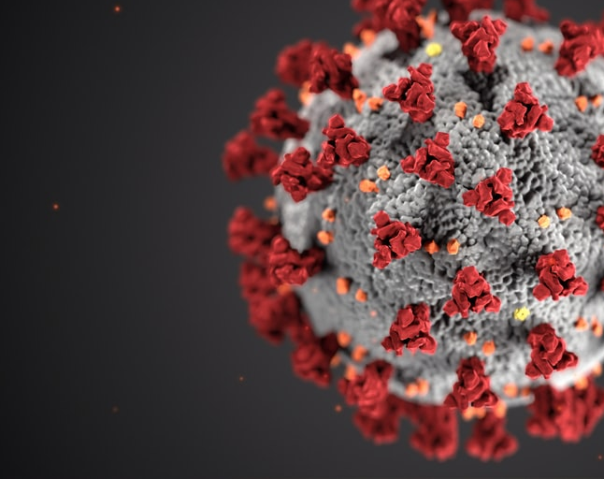
SNF COVID-19 SURVEY NHSN REGISTRATION
May 2020

Slide 2
Why Does My Facility Need to Enroll in NHSN?
All CMS-certified facilities must enroll in the National Healthcare Safety Network (NHSN) LTCF COVID-19 Module. This is a CMS requirement.
Enrollment should start ASAP.
First set of data submitted by 5/17 (grace period through 5/24).
Non-compliance can result in citation and/or penalty (QSO-20-29-NH).
If your facility enrolls with NHSN and confers rights to CDPH:
CDPH can batch upload to NHSN/CDC the COVID-19 reporting that you provide to CDPH on your behalf
Double data entry can be eliminated.
We can ensure data consistency across facilities, CDPH, and NHSN/CDC.
Important: If the facility is already enrolled in NHSN and registered with SAMS, please do NOT re-enroll. You only need to join the CDPH group and confer rights.

Slide 3
How to Enroll in NHSN
1. PREPARE TO ENROLL
Enables facilities to submit data to NHSN separately from submitting data to CDPH
2A. REGISTER WITH NHSN
Enables CDPH to submit data on behalf of facilities.
2B. REGISTER WITH SECURE ACCESS MANAGEMENT SERVICES (SAMS)
3. COMPLETE NHSN LTC ENROLLMENT
4. ACCEPT NHSN AGREEMENT TO PARTICIPATE AND CONSENT
JOIN CDPH GROUP AND CONFER RIGHTS TO CDPH

Slide 4
How to Enroll in NHSN
1. PREPARE TO ENROLL
System Requirements: Internet connection and browser:
Internet Explorer 11 (latest version), Microsoft Edge (latest version), Chrome (latest version), Firefox (latest version), or Safari (latest version)
CCN - CMS Certification Number or CDC Registration ID (contact NHSN@cdc.gov)
CCN Look up Tool https://qcor.cms.gov/main.jsp
NHSN Facility or Group Administrator Identified – To be the point of contact for receiving information from NHSN and other functions in the application.
NHSN enrollment guide is provided here:
https://www.cdc.gov/nhsn/pdfs/covid19/ltcf/covid19-enrollment-508.pdf

Slide 5
How to Enroll in NHSN
2A. REGISTER WITH NHSN
Access NHSN registration: https://nhsn.cdc.gov/RegistrationForm/index
Read and agree to the NHSN Rules of Behavior
Follow the instructions in the NHSN enrollment guide to complete and submit your enrollment
Within 2 days, you will receive 2 e-mails: “Welcome to NHSN” from (NHSN@cdc.gov) and Invitation to Register with SAMS from (SAMS-NO-REPLY@cdc.gov).

Slide 6
How to Enroll in NHSN
2B. REGISTER WITH SECURE ACCESS MANAGEMENT SERVICES (SAMS)
Open the Invitation to Register with SAMS e-mail and clink the link to SAMS where you will be guided to their Log In Screen
Enter the username (email address) and temporary password provided in the email and click the Login button.
After clicking “Login” the SAMS Rules of Behavior screen displays. Read the SAMS Rules of Behavior and click the Accept button.
After accepting the SAMS Rules of Behavior, you will be taken to the SAMS registration page. Enter the information in the fields displayed. Fields marked with an asterisk are required.
Click SUBMIT to complete your SAMS registration.

Slide 7
How to Enroll in NHSN
3. COMPLETE NHSN LTC ENROLLMENT
Access the SAMS log-in page by clicking on this link https://sams.cdc.gov
Enter your username and password to log in
Under “My Applications” click on the “NHSN LTC Enrollment” link to go to the NHSN Enrollment page.
Select Enroll a Facility
Follow the instructions to complete the enrollment.

Slide 8
How to Enroll in NHSN
4. ACCEPT NHSN AGREEMENT TO PARTICIPATE AND CONSENT
After successfully completing enrollment, the Facility will receive an NHSN Org ID.
The Administrator and Component Primary Contact (if different) will receive an NHSN email with further instructions on how to electronically accept the NHSN Agreement to Participate and Consent

Slide 9
How to Enroll in NHSN
JOIN CDPH GROUP AND CONFER RIGHTS TO CDPH
CDPH has a Group Administrator.
CDPH will invite LTC facilities to join the CDPH Group by providing the LTCFs with the Group ID as well as the joining password.
The Facility logs in to NHSN, and an alert will appear on the Action Items tab to confer rights (COVID-19 View Data and CSV Data Upload). This enables CDPH to upload data to NHSN on behalf of the facility.

Slide 10
What to Do
If you HAVE NOT enrolled with NHSN:
Complete the NHSN enrollment process
Join the CDPH group and confer rights after you receive an email from CDPH about this
Continue to report your COVID19 data using the CDPH Survey 2.0
CDPH will upload your data to NHSN for you so you won’t need to report the same data to NHSN
If you HAVE enrolled with NHSN and been reporting to NHSN:
Join the CDPH group and confer rights after you receive an email from CDPH about this
Continue to report your COVID19 data to CDPH Survey 2.0
CDPH will upload your data to NHSN for you without overriding what you already reported to NHSN
CDPH will let you know when you can stop reporting to NHSN and only need to report to CDPH Survey 2.0

Slide 11
Helpful Information
More information can be found at:
CDPH SNF COVID-19 Web Page
CCN - CMS Certification Number or CDC Registration ID (contact NHSN@cdc.gov)
CCN Look up Tool https://qcor.cms.gov/main.jsp
NHSN enrollment guide is provided here:
https://www.cdc.gov/nhsn/pdfs/covid19/ltcf/covid19-enrollment-508.pdf
CMS QSO-20-29-NH Notification:

Slide 12
If You Have Any Questions
If you have any questions, send an email to:
COVID-19SNFSURVEY@CDPH.CA.GOV

