Slide 1
Presentation Instructions
This Zika 101 presentation provides answers to commonly asked questions about Zika that can be used within your local agency and for outreach or education to the public.
You may use this presentation “as is” with the CDPH logo, or you may co-brand with your agency’s logo if desired.
If you wish to change the content of the slides and customize to your own needs, please remove the CDPH logo from the altered slides, but you are welcome to acknowledge technical assistance and/or graphics from the CDPH.

Slide 2
ZIKA 101
California Department of Public Health
Notes:
General public presentation

Slide 3
Presentation Overview
This presentation will provide answers to common questions about Zika:
What is Zika?
Should I be worried about Zika?
How do you get Zika?
Is Zika in California?
How do you prevent Zika infection?

Slide 4
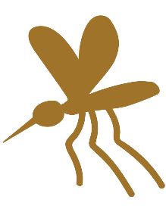
What is Zika?
Zika is a mosquito-borne virus that is also sexually transmitted.
Zika is most common in areas of the world that are warm or tropical, including:
Central and South America (including Mexico)
Caribbean and Pacific Islands
Some countries in Africa and Asia
Certain mosquitoes in these areas are infected with the Zika virus and can spread it to people when they bite them.

Slide 5
Should I be worried about Zika?
Anyone can get Zika if they haven’t been infected before.
Most people infected with Zika don’t have symptoms, so they might not even know they have the virus.
Zika is of greatest concern to a pregnant woman’s developing baby. Zika can cause birth defects if a pregnant woman becomes infected.
It is important to avoid areas with Zika, prevent mosquito bites, and practice safe sex to prevent the spread of Zika.

Slide 6
Is Zika in California?
In the United States, Zika has been spread by mosquitoes in some parts of Florida and Texas, but not in California.
The mosquitoes that can spread the Zika virus are in certain areas of California, but mosquitoes infected with Zika virus have not been found.
The only cases of Zika in California have been in people who have gone to countries with Zika and have been infected while traveling OR have had sex with someone who traveled and returned infected.
The risk of Zika virus transmission by infected mosquitoes in California is low.

Slide 7
How do you get Zika?
Through Mosquitoes:
Zika is transmitted to people mainly through the bite of infected mosquitoes (Aedes aegypti or Aedes albopictus) that are in areas of the world with active Zika virus transmission.
Mosquitoes that can spread Zika are in some parts of California, but they can only transmit and spread Zika after biting a person who is already infected with Zika (called “local transmission”).
To date, there has been no local transmission of Zika virus in California, but Zika infections have occurred in people returning from travel to areas with Zika, or by having sex with someone who has been infected while traveling.

Slide 8
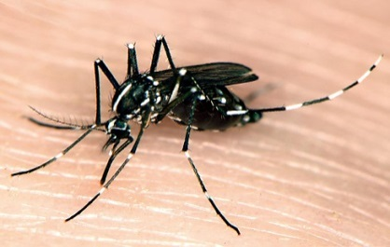
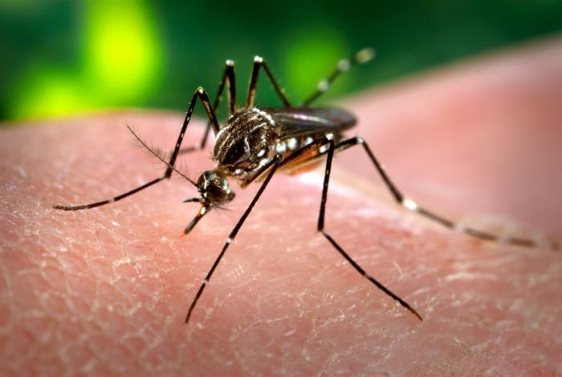
Mosquito Vectors for Zika
Aedes aegypti and Aedes albopictus mosquitoes
Also transmit dengue and chikungunya viruses
Live in and around households
Lay eggs in household or backyard containers
flower pots, old tires, pet dishes
Aggressive daytime biters
Aedes albopictus
Photo Source: CDC
Aedes aegypti
Photo Source: CDC

Slide 9
How do you get Zika or pass it on?
2) Through Sex:
You can also get Zika through sexual contact with an infected person (male or female) who has recently been to an area with Zika.​
Sexual contact includes:
vaginal, anal or oral sex between:
males and females
females and females
males and males
sharing sex toys

Slide 10
How else can you get Zika or pass it on?
3) From Mother to Developing Baby:
If a pregnant woman becomes infected with Zika, she can pass the virus to her developing baby.
Zika virus infection during pregnancy can cause:
miscarriage
stillbirth
severe birth defects (like microcephaly)
It is very important that pregnant women protect themselves and their developing babies from the Zika virus.
There is NO specific medicine or vaccine for Zika.

Slide 11
Areas with Zika
Going to areas with Zika puts you at risk for infection.
Pregnant women should not go to these areas.
Zika is active in warm or tropical areas of the world, including:
Mexico
Puerto Rico
Central & South America
Caribbean Islands (including the Dominican Republic, Jamaica, US Virgin Islands)
Pacific Islands (including Fiji and Papua New Guinea)
Some countries in Africa and South East Asia
If you must travel to these areas, talk to your doctor first.

Slide 12
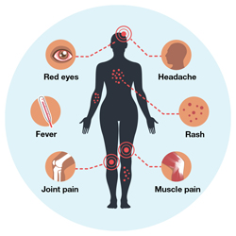
Symptoms
Most people infected with Zika have no symptoms.
This means an infected person can pass the virus to someone
without even knowing it.
If you do get symptoms, the most common are:
fever, rash, joint pain and red eyes
If one or more symptoms do occur, they usually begin a few days after being bitten by an infected mosquito or having unprotected sex with someone who is infected. The illness is usually mild with symptoms lasting about a week.
See your doctor if you have these symptoms and have recently been to an area with Zika. The greatest risk of Zika is to a pregnant woman’s developing baby.
Image Source: CDC

Slide 13
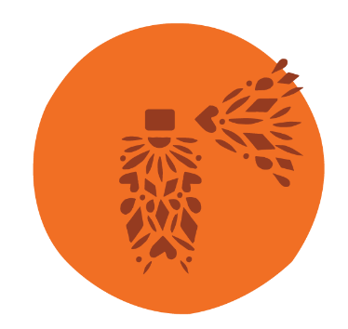
Prevention – Mosquito Transmission
Prevent mosquito bites
Use EPA-registered insect repellent when going to areas with Zika.
EPA-registered insect repellent is safe for pregnant and breastfeeding women to use as directed by the label instructions.
Do not use insect repellent on babies younger than 2 months of age.
Wear long sleeves and long pants when possible.
Stay and sleep in screened-in or air-conditioned rooms, or use a bed net.
When you return home, continue using insect repellent for 3 weeks to prevent spreading Zika in your neighborhood.

Slide 14
Prevention – Sexual Transmission
Practice safer sex
Use condoms (male or female) and dental dams during all types of sex during and after travel.
Men: Practice safer sex for at least 3 months after being in an area with Zika.
Women: Practice safer sex for at least 2 months after being in an area with Zika.
If you or your partner are pregnant, either do not have sex or use condoms for the rest of your pregnancy.
Not having sex is the only way to be sure that you do not get sexually transmitted Zika.

Slide 15
Protect Your Family
If you are pregnant or planning pregnancy, avoid going to areas with Zika.
If you must go, or if you have recently been to areas with Zika, talk with your doctor.
If you or your partner are already pregnant: Either do not have sex or practice safer sex using condoms for the rest of the pregnancy.
Not having sex is the only way to be sure that you do not get Zika through sex.
Condoms will help prevent Zika transmission during sex.
Preventing Zika transmission can help prevent Zika-related birth defects in your developing baby.

Slide 16
Not Planning Pregnancy?
If you are not planning pregnancy, it is important to prevent accidental pregnancy while traveling in areas with Zika.
If you go to areas with Zika, use a long-acting, effective birth control method.
examples: IUDs or implants
Use condoms and an effective birth control method to delay pregnancy until it is safe (for at least 2 months for female travelers, and 3 months for male travelers).
Search for a family planning provider by ZIP code at: http://www.familypact.org
Find more information on birth control methods and how to get them at: www.bedsider.org

Slide 17
Remember…
Don’t go to areas with Zika if you are pregnant or planning pregnancy.
Everyone going to areas with Zika should use mosquito repellent for a safe visit.
Zika is transmitted through sex – use condoms during sex if you or your partner have been to areas with Zika, even if you are already pregnant or are in a serious relationship.
If you or your partner are pregnant, either don’t have sex or use condoms for the rest of the pregnancy.
Keep your family and California safe — Don’t Bring Zika Home!

Slide 18
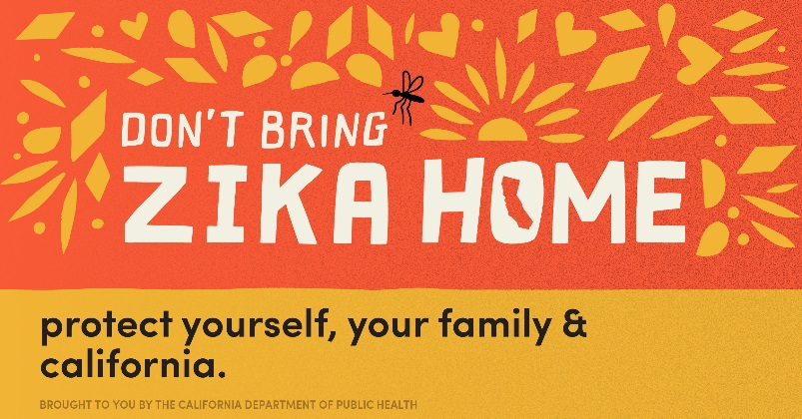
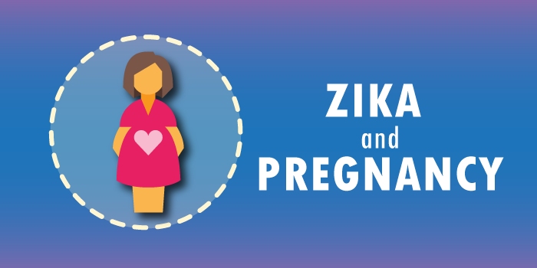
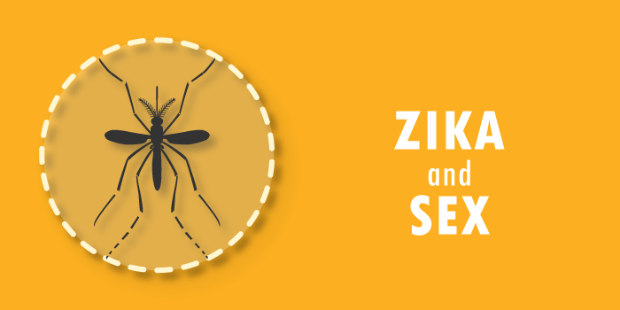
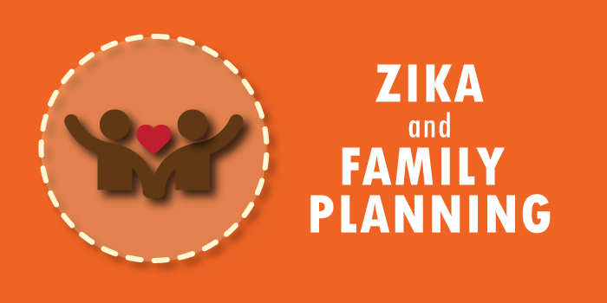
CDPH Zika Resources (in English and Spanish)
Don’t Bring Zika Home
Posters and Digital Graphics
www.ZikaFreeCA.com
Zika Toolkits
www.cdph.ca.gov/Zika
Zika + Pregnancy
Zika + Sex
Zika + Family Planning
Zika + Travel
Zika + Men

