Slide 1
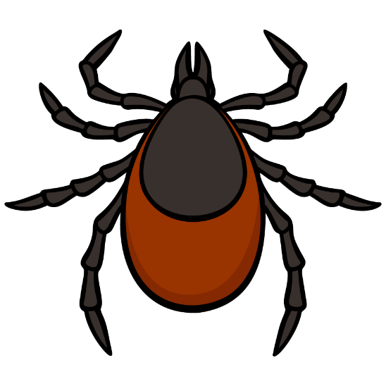

Don’t Let the Ticks Bite!
California Department of Public Health
Vector-Borne Disease Section
Don't Let
the
Ticks Bite!
California Department of Public Health
Vector-Borne Disease Section

Slide 2


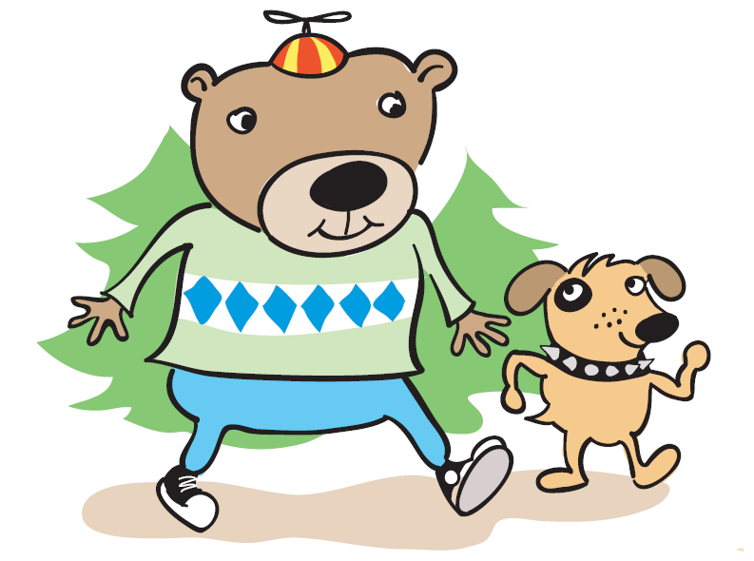
Introducing: Timothy Tickfinder and his dog Bullseye
Timothy Tickfinder
and his dog Bullseye
Notes:
Timothy Tickfinder is an adventurous fellow who likes to go exploring outdoors with his dog, Bullseye. Timothy and Bullseye take frequent walks outdoors in areas where ticks could be lurking. But have no fear! Timothy and Bullseye know just what to do to prevent tick bites, and they can help us learn about ticks and tick-bite prevention along the way.

Slide 3
Timothy & Bullseye will help us learn:
What ticks are
What ticks eat
Where ticks live
Why we need to learn about ticks
How to protect yourself from ticks
What to do if you find a tick

Slide 4

So…what are ticks?
Notes:
Are ticks bugs? Insects? Spiders?

Slide 5
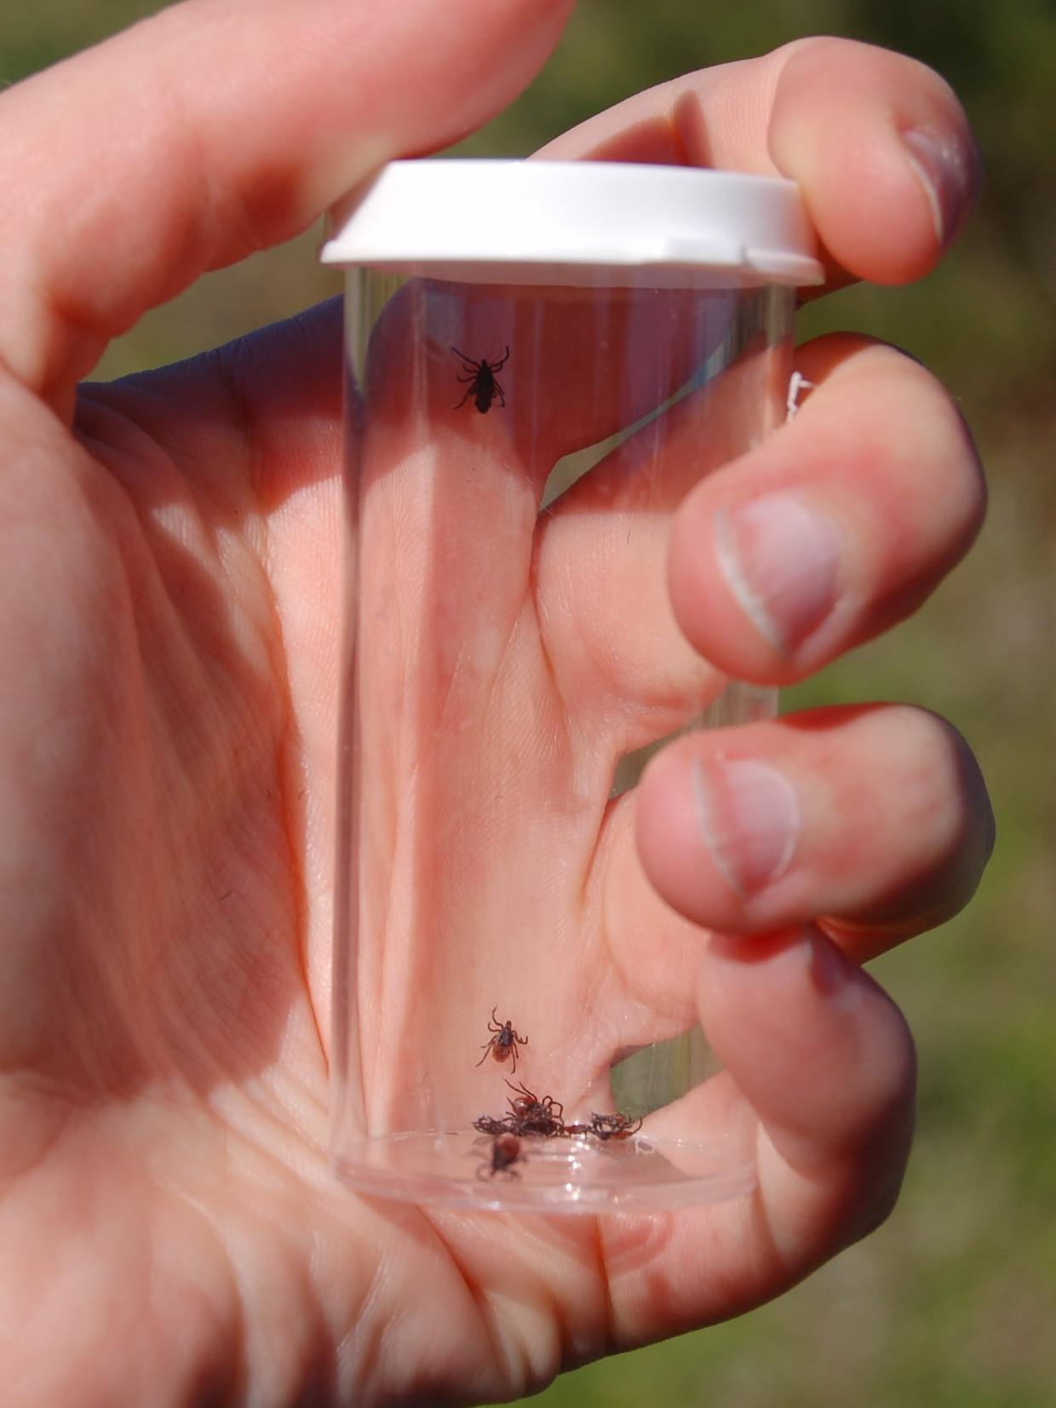
Ticks are small arthropods that look like spiders and need to eat blood to survive.
Let’s learn about the different kinds of arthropods so we know a tick when we see one!
Don’t Let the Ticks Bite!
Notes:
Vocabulary:
Arthropods: Invertebrate animals with a hard exoskeleton (which means they have no bones inside), segmented bodies (which means their bodies have different sections), and paired jointed appendages (such as legs, etc.)
Can you think of anything else that looks like a spider? Why does it look like a spider?

Slide 6
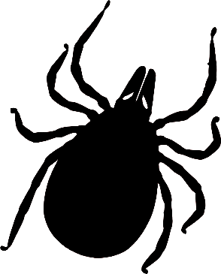
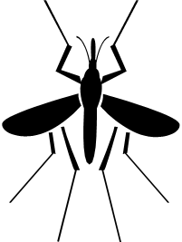
Two different kinds of arthropods:
Arachnids
Insects
8 legs
No antennae
2 body sections
  Head
  Abdomen
  (body)
Ticks are arachnids
(like spiders!)
6 legs
Antennae
3 body sections
  Head
  Thorax
  Abdomen
Mosquitoes are insects (like butterflies or ants!)
Notes:
There are other types of arthropods, but the two types that you are most likely to encounter are arachnids and insects.
Vocabulary:
Arachnids: Type of arthropod with 8 legs, no antennae, and a body with 2 main sections. Examples: spiders, ticks.
Insects: Type of arthropod with 6 legs, antennae, and a body with 3 sections. Examples: mosquitoes, butterflies, beetles.
Antennae: Long, thin body parts attached to the head of insects that help them sense things, such as touch and smell.
Thorax: Middle body section of an insect that is behind the head and before the abdomen.
Abdomen: Body section farthest away from the head that holds most of the internal organs.

Slide 7

Parts of a Tick
Capitulum (mouthparts)
Legs
(4 pairs = 8 legs)
Scutum (hard cover
or body shield)
Abdomen (body)
Notes:
Vocabulary:
Capitulum: The mouthparts of a tick.
Abdomen: The softer body section of a tick that holds most of the internal organs. For a female, the abdomen can expand while eating.
Scutum: The hard covering or shield on the back of the abdomen. The scutum is small for female ticks, but it covers the whole back of a male tick. (This image shows a female).

Slide 8

How BIG are ticks?
(not very big)
Ticks are tiny!
  You might need a
  magnifying glass to see
  all their body parts
Ticks get bigger as they grow
  Different life stages are different sizes

Slide 9

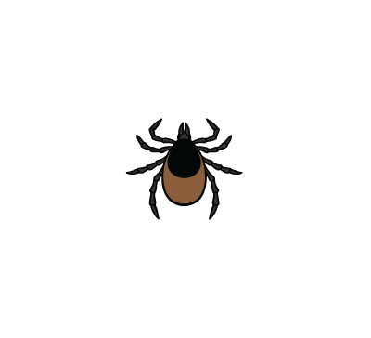
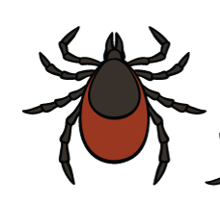

Tick Life Stages
Egg
Larva
Nymph – about the size of a poppy seed
Adult (female) – about the size of an apple seed
Notes:
Vocabulary:
Larva: The immature (not fully-grown) life stage of a tick that comes after the egg stage, but before the nymph stage. Larval ticks have only 6 legs.
Nymph: The immature life stage of a tick that comes after the larva stage, but before the mature adult stage. Nymphal ticks have 8 legs.
Adult: The final, mature life stage of a tick. Adult ticks have 8 legs. Adult female ticks will lay eggs.

Slide 10


Tick Life Stages and Size
Size of a nymphal
tick
Size of an adult
(female) tick
Notes:
Real-life examples: poppy seed and apple seed

Slide 11
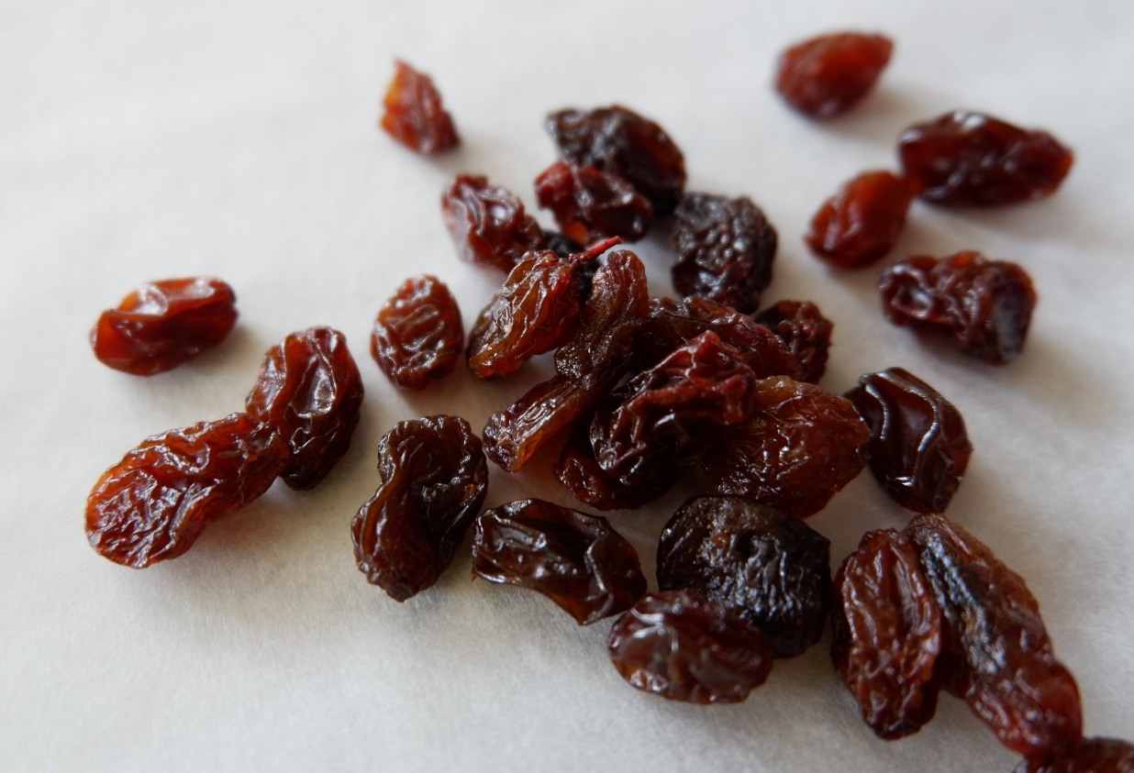
Tick Life Stages and Size (continued)
Size of an adult tick that’s finished eating
Notes:
Real-life example: raisins

Slide 12


Tick Times of Year
Ticks lay their eggs in Spring
Later… the eggs hatch – larvae and nymphs are common in the following Spring seasons
Full-grown, blood-sucking ticks are common in Fall (think Halloween) and Winter
Notes:
The entire life cycle for the most common tick in California takes 2 and a half years to complete. After a tick lays eggs, it will take 2.5 years for the ticks to be fully grown.
Larvae is the plural of “larva”.

Slide 13
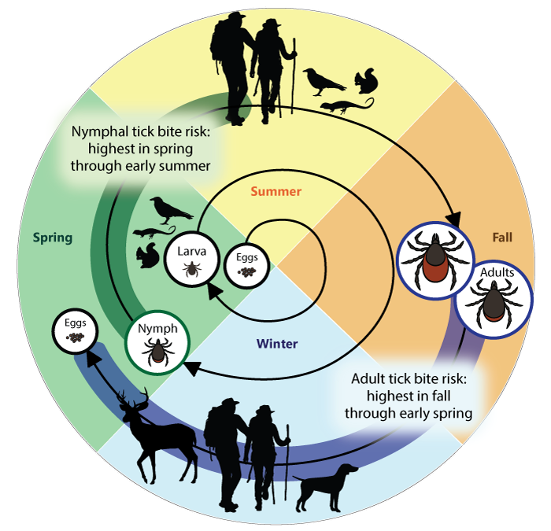

Tick Times of Year (continued)
Anytime I’m out for a walk, I could find a tick!
Anytime you’re out for a walk in California, you could find a tick!
Notes:
(Start at “Eggs” in the middle of the circle, and follow the spiral line around through the seasons.)
Bullseye enjoys going on walks all year round – do you think he could pick up a tick at any time of the year? Yes! Ticks are active all year round in California.

Slide 14







What do ticks eat?
Notes:
What do you think ticks eat? Leaves, flowers, nectar, or maybe human food, like ants? Answer: Ticks eat blood!

Slide 15
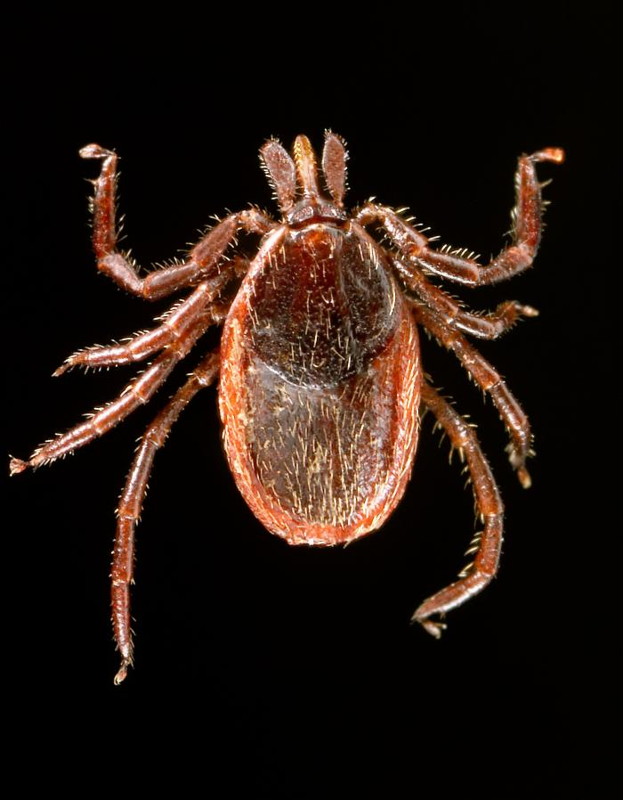
How do ticks eat?
Ticks eat by attaching to animals and sucking their blood.
Part of a tick’s capitulum has special mouthparts called a hypostome, which a tick uses to pierce the skin to eat.
Notes:
Vocabulary:
Hypostome: Toothed mouthparts that ticks use to pierce the skin. The hypostome gets into the skin like a needle.

Slide 16
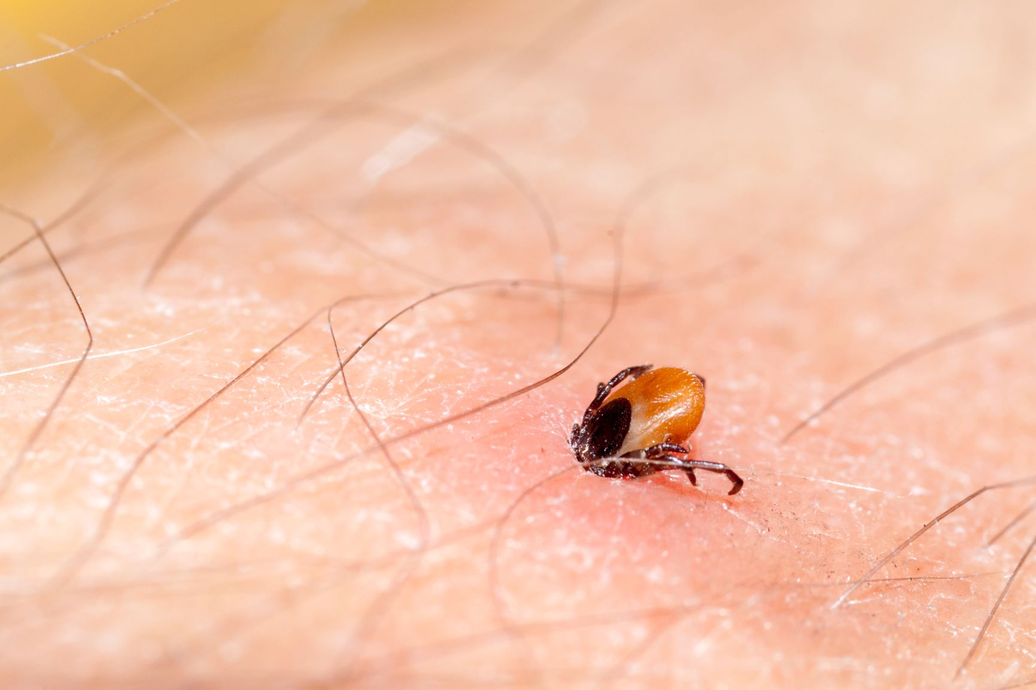
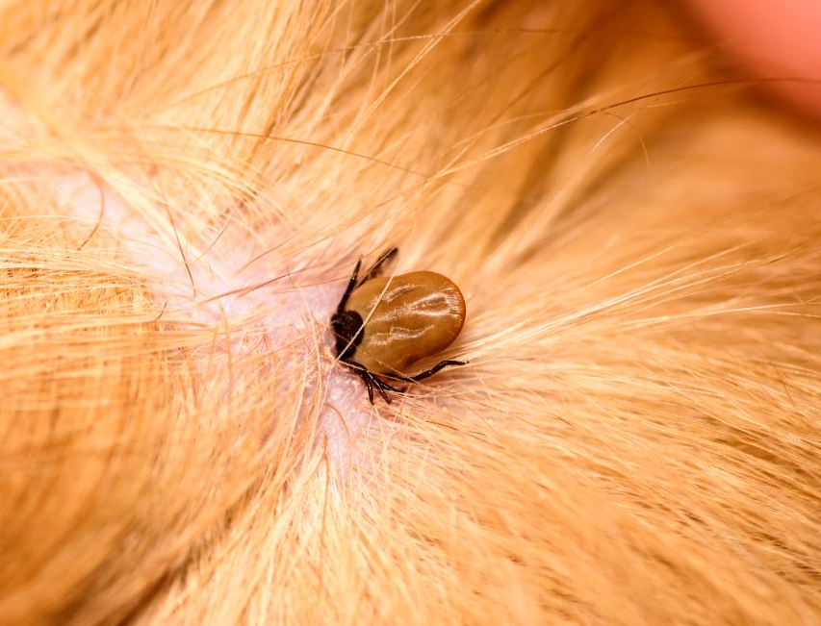
How do ticks eat? (continued)
When a tick is biting, it spits saliva into the skin. The saliva contains:
  Numbing agents (so you can’t feel it biting)
  Blood thinners (so it can easily suck your blood)
Some ticks may spread germs that can make people and pets sick!
Notes:
Pictures show an embedded tick in human skin and in animal skin/fur. Ticks embed their mouthparts into skin to suck blood.
Ticks can spread germs like bacteria and parasites when they bite and suck blood.

Slide 17

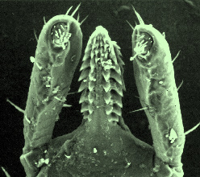
What part of the tick are Timothy and Bullseye looking at?
The hypostome! Those teeth look sharp!
The hypostome! Those teeth look sharp!
Notes:
Why do ticks need sharp teeth?

Slide 18


Do all ticks look the same?
Notes:
Answer: No!
Males and females of the same species (or type of tick) look different from each other, AND different types/species of ticks look different from one another.

Slide 19
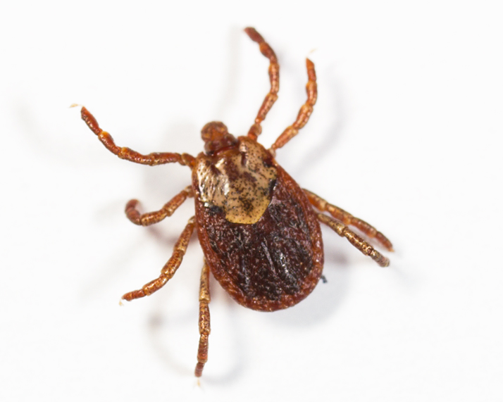
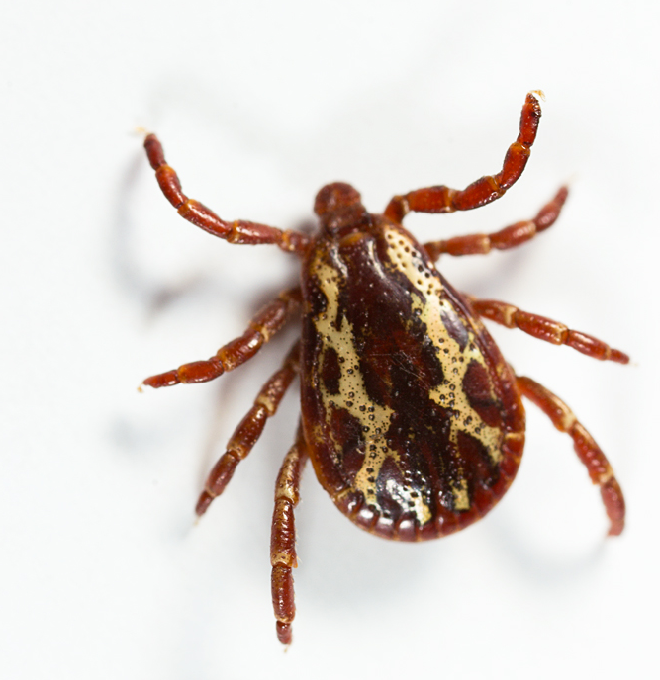
Male vs. Female Ticks
Female ticks have a small scutum (hard cover) on their back
Male ticks have a long scutum that covers their whole back
Notes:
Male and female ticks may have different patterns or coloring on their “backs”. You can tell the difference between a male and female tick by the size of the scutum – females have a small scutum.

Slide 20
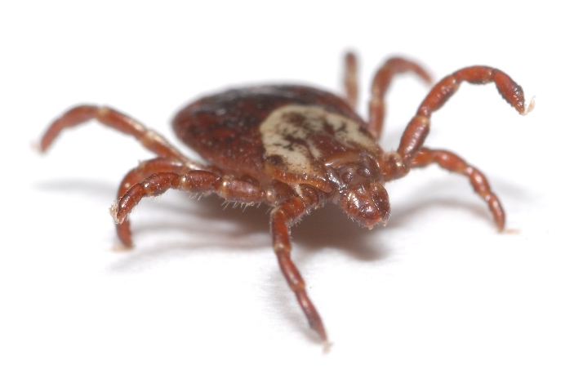
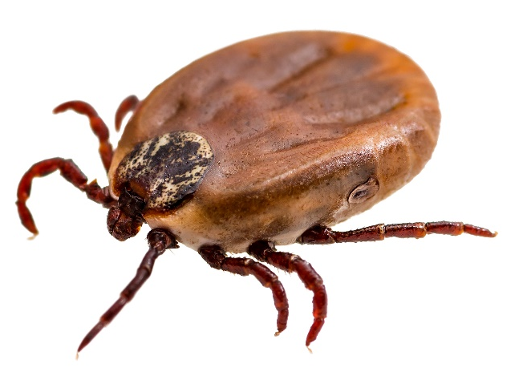
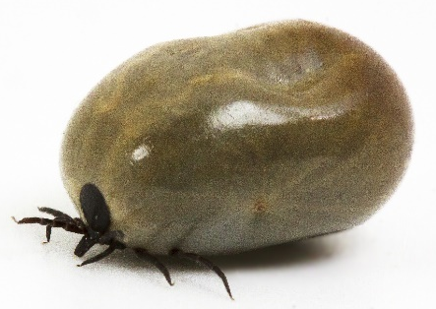
Empty vs. Full of Blood
When a female tick hasn’t eaten, it’s usually flat
After a tick eats, its body fills with blood, and it looks much bigger
I’m full…
Notes:
Ticks can look different depending on whether they have eaten/fed on blood. Think of a balloon or football. Without any air, it’s flat. But when it’s filled up, it’s much bigger and rounder. Remember the picture of the raisins a few slides ago? A tick full of blood is about the size of a raisin.

Slide 21
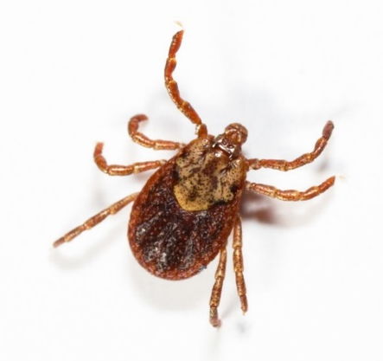
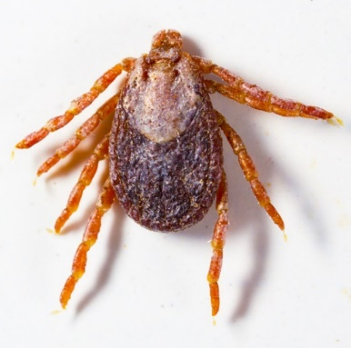
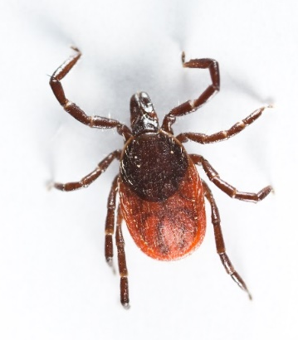
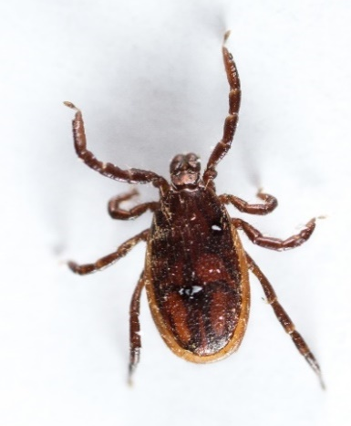
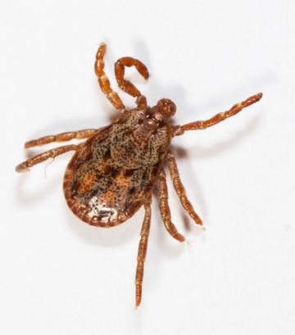
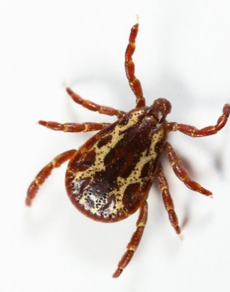
Ticks in California
(that bite people!)
 | Western blacklegged tick | Pacific Coast tick | American dog tick
Female
Male
Western blacklegged tick
Pacific Coast tick
American dog tick
Notes:
There are different types of ticks that live in California – each look a little bit different (have different “decorations” on their back), but they all have the same body parts and do the same thing – bite to feed on blood! Not all ticks in California bite humans specifically, but these do. Each of these ticks can spread diseases to people when they bite, including Lyme disease.

Slide 22
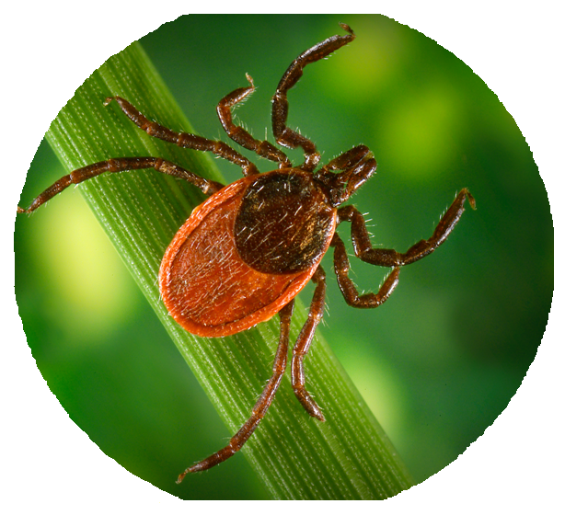
Can you look and see if a tick is carrying germs?
This type of tick could spread
Lyme disease.
No, but certain types of ticks are more likely to carry certain germs. This type of tick (Ixodes pacificus) could spread Lyme disease.
No, but certain types of ticks are more likely to carry certain germs.
Notes:
If you look closely, can you tell if a tick is infected with germs? Nope! But certain types of ticks carry different types of germs that can make people sick.
Bonus question: Is the tick that Timothy Tickfinder found a male or a female?
(Answer: Female – because of the short scutum)

Slide 23




Where do ticks live?
Notes:
Where do you think ticks live or are naturally found? Outside or inside?
Where outside? Where inside?

Slide 24
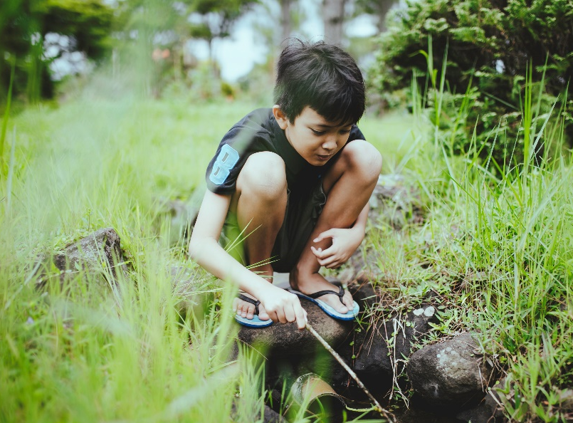
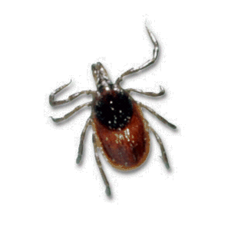
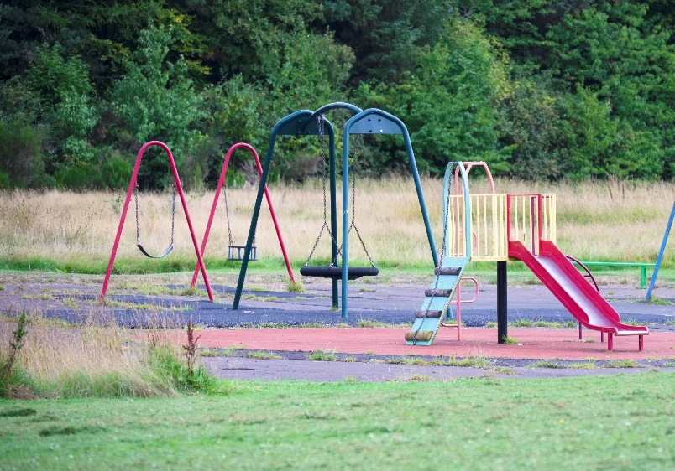
Tick Habitat
Ticks ARE found outside in wild, overgrown areas with trees, shrubs, and tall grass
  Hiking trails
  Grassy fields
  Shady areas with rocks and leaves
Ticks are NOT found
on sandy beaches, up in the tops of trees, or in the snow
Home sweet
home
Notes:
Vocabulary:
Habitat: The natural environment where something lives; the type of place where it is natural for something to live and grow.
Ticks like to live in shady, overgrown areas outside, especially along trails or in areas with tall grass.
Ticks might live in areas where you like to explore with your family, friends, or pets (when going for a walk, camping, or going on a picnic). These might even be areas that are nearby where you live.

Slide 25




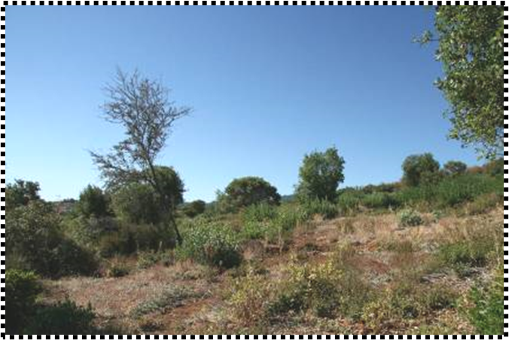
Tick Habitat (continued)
Notes:
Additional images of tick habitat.
Remember, ticks don’t live in the snow or on sandy beaches.
Ticks don’t live in very hot or very cold areas – ticks need just the right temperature (not too hot, not too cold) to live and thrive.

Slide 26
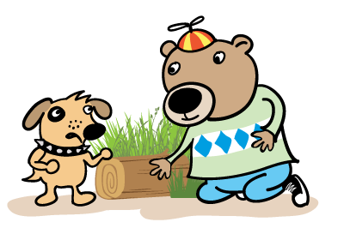
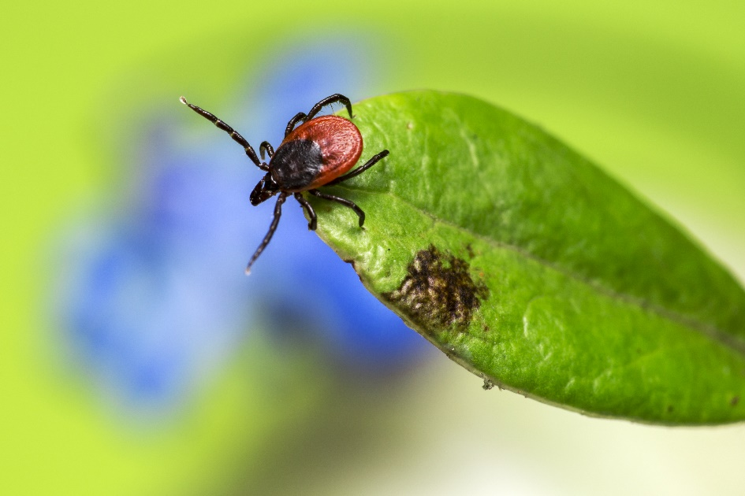
Questing
Ticks like to hang out at the edges of hiking trails and on rocks and logs
Ticks wait at the end of a piece of grass until an animal or person brushes against them…
  Then they crawl on to find a good place to feed!
  (Ticks do not jump or fly)
This is called QUESTING
Notes:
See the tick with its front legs stretched out? Ticks stretch out their legs to try and grab onto an animal or person passing by.
Vocabulary:
Questing: When a tick is searching for an animal to attach to (like a knight on a quest).

Slide 27
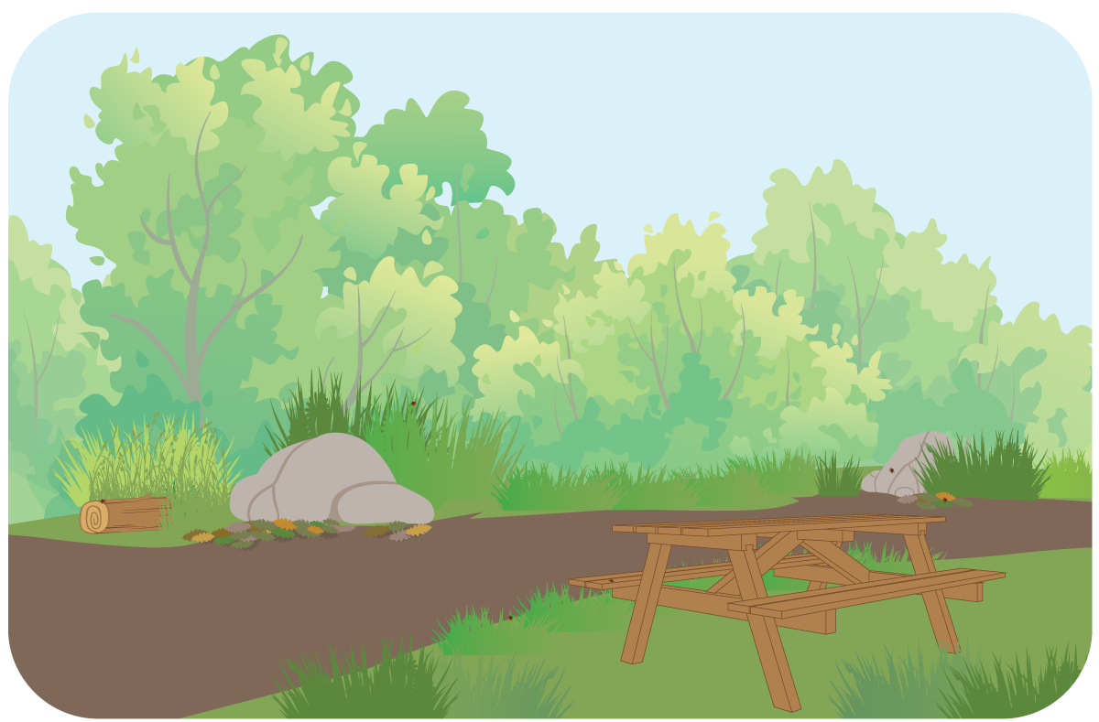

Where would Timothy & Bullseye find ticks on their hike?
Notes:
Ticks can be found hiding in natural areas outside, especially along trails or picnic sites with tall grasses.
Ticks in this scene can be found: on rocks and logs, on tall grasses on both sides of the trail, on the picnic bench, in leaves on the ground.

Slide 28

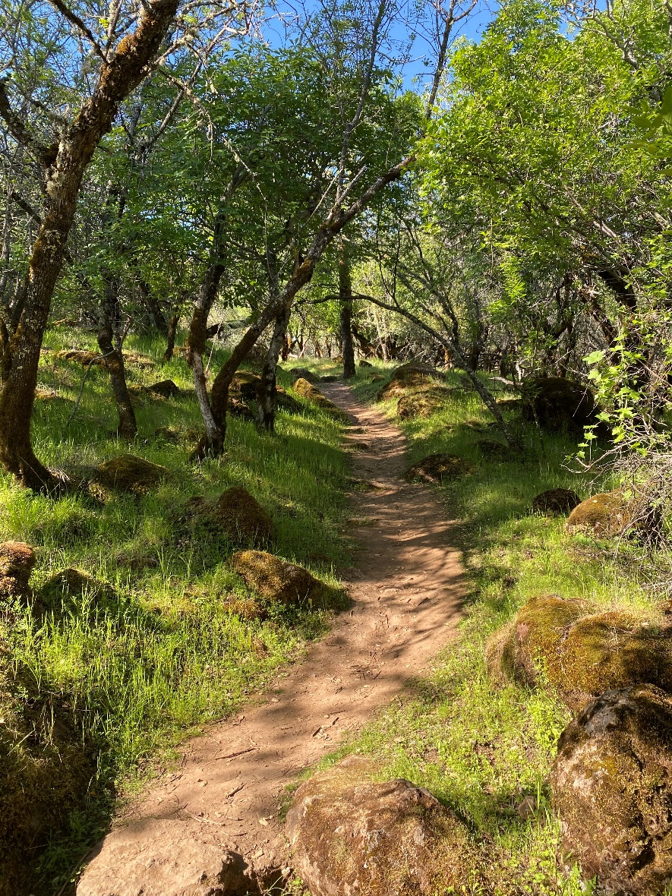

Where would you find ticks on a hike?
Notes:
Now, let’s practice finding tick areas in a real-life picture – where would you find ticks in this picture? Where would you not find ticks?
Ticks: Trail edge & rocks
No ticks: Middle of trail & up in the tree.
Why do you think ticks aren’t found in the middle of a trail or up in trees?

Slide 29


How can we protect ourselves from ticks?
Notes:
At this point we know that ticks can spread germs when they bite and where ticks are commonly found. Now we need to learn how to protect ourselves from ticks!

Slide 30

Use repellent when outdoors
Protect yourself from ticks by wearing bug repellent
  Usually comes as a spray
You should ask for help from an adult to use repellent (it’s important
to follow the label instructions closely)
Notes:
Vocabulary:
Repellent: something used to keep bugs, insects, or pests away; tick repellent is usually something that you spray on your clothes and skin that keeps ticks from finding and biting you. Repellent works by blocking a tick’s ability to “smell” you.
Using tick repellent is an important way to protect yourself from ticks. An adult can help you safely apply repellent on your clothes and skin so you can have fun outdoors and play without having to worry as much about ticks crawling on you and biting you.
Tick repellent doesn’t kill ticks or other bugs, it just keeps the ticks from being able to find and bite you.

Slide 31




Wear protective clothing
Wear long pants and a long-sleeved shirt in light colors so it’s easier to spot a tick crawling on you
Notes:
Is it easier to spot the tick on the white shirt or the black shirt?

Slide 32

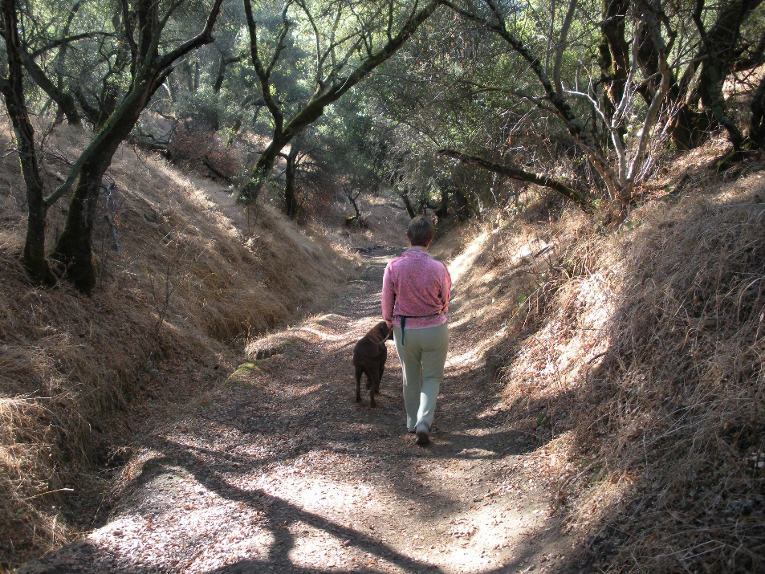
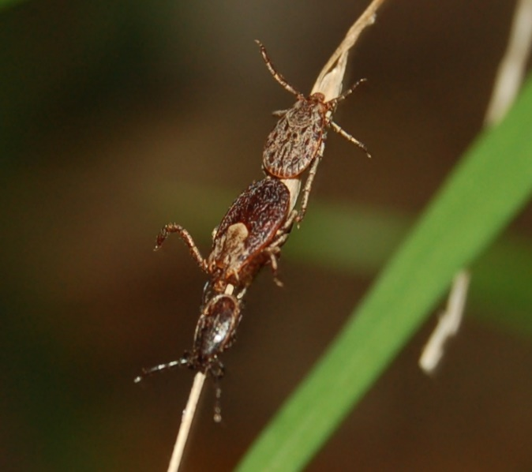
Be aware of ticks when outside
Stay in the middle of the path when hiking or exploring
Try not to brush up against bushes, shrubs, or grass
Notes:
Remember, ticks like to hang out on tall grasses with their arms/legs stretched out ready to crawl onto you! (Do you remember what it’s called when ticks do that?) Now that you know the areas outside where ticks can be found, you can be on the lookout for any hitch-hiking ticks!

Slide 33

Check your body for ticks
Check your body for ticks while you’re outside and after coming indoors
Ask a parent to help you check for ticks where you can’t see (like your back)
  Ticks like to find a good hiding place on your body, so it can be hard to find them
Notes:
Checking your body for ticks is also really important. By checking for ticks, you can find and get rid of any ticks crawling on you before they bite. When you’re outside exploring or playing, stop every once in awhile to check your body and clothes for ticks. If you’re outside with someone else, ask a parent or friend to check areas that you can’t see (like your back). You should also check for ticks after coming inside after being outdoors. Ask a parent to help you look all over your body for ticks.

Slide 34
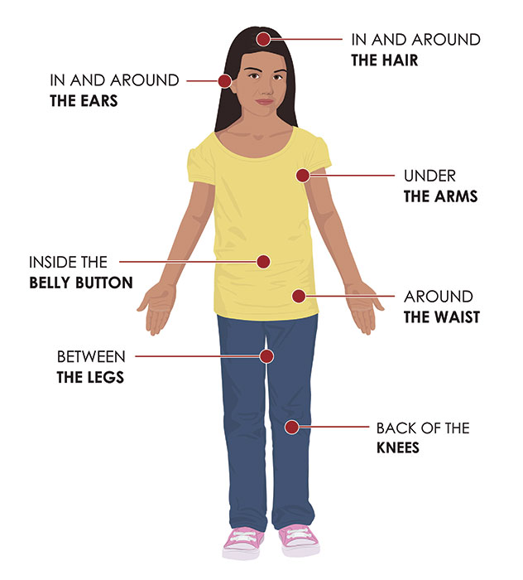
Check your body for ticks (continued)
Image: CDC
Notes:
Ticks like to find a good hiding place on your body – check these areas for ticks!

Slide 35

Check pets for ticks
Pets can bring ticks inside the house, so check them carefully!
Ticks can easily hide in your pet’s fur.
Notes:
Check your pet every day for ticks, especially after they spend time outside. Run your fingers through your pet’s fur to feel for any small bumps. If you find a tick, ask an adult to help you remove it.

Slide 36
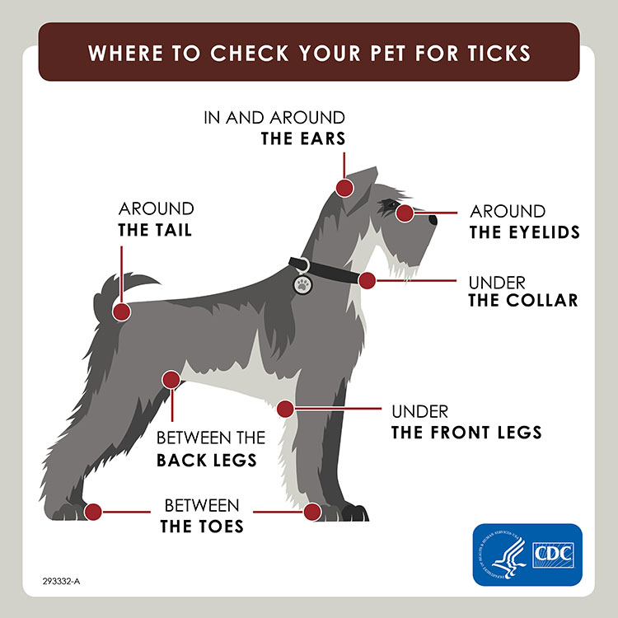
Check pets for ticks (continued)

Slide 37


What should you do if you find a tick on your body?

Slide 38


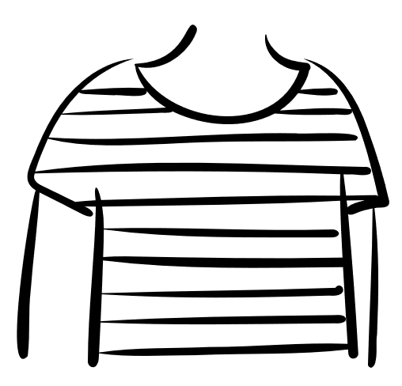

If you find a tick crawling on you…
Don’t worry, it happens to me all the time…

Slide 39

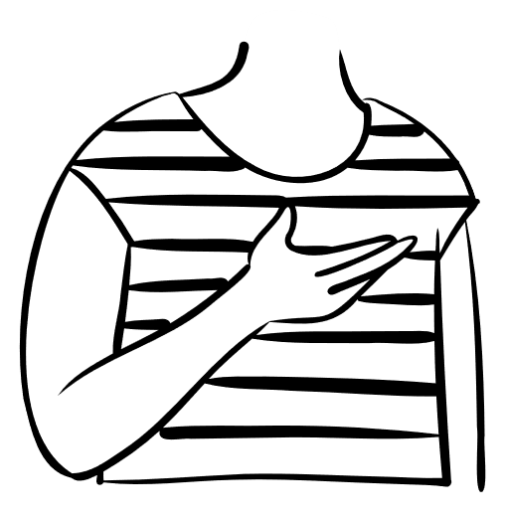

If you find a tick crawling on you (continued)
Brush or flick
it off.
Notes:
If you’re outside and you find a tick crawling on you, don’t panic! Just brush or flick it off. But tell an adult so they know ticks are in the area and that more tick checks might be needed.
If you’re inside the house and find a tick on you, grab it with a tissue or paper towel and take it outside or flush it down the toilet.

Slide 40





If you find a tick ATTACHED to your skin…
Tell an adult –
biting ticks should be removed right away.

Slide 41

If you find a tick ATTACHED to your skin…(continued)
An adult can help you get the tick out of your skin safely using tweezers.
Do not squish or crush
the tick.
Notes:
You shouldn’t squish a tick because it could be filled with blood and germs that could make you sick.

Slide 42
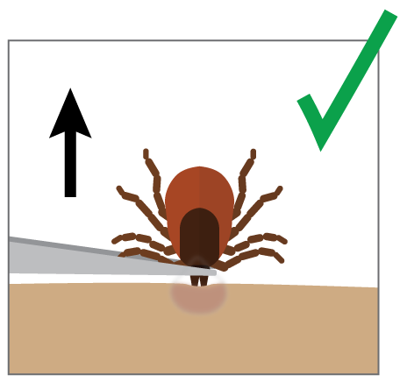
How to remove a tick the RIGHT way
An adult should use tweezers (or a tissue) to grab the tick as close to your skin possible.
Slowly and steadily pull the tick up and out – do not jerk or twist the tick.
Put the tick in a sealed bag or flush it down the toilet.
Clean the bite area (and your hands) with soap and water.
Notes:
Tweezers are the best way to remove a tick, but if an adult doesn’t have tweezers with them, they can also use a tissue to grab and remove the tick.

Slide 43
Why should you remove a tick right away?
Ticks can spread germs when they bite.
It’s important to remove a tick as soon as you find one so you don’t get sick.
If you feel sick after a tick bite, tell an adult so that you can talk to a doctor.

Slide 44
Now, get out there and start exploring!
Because now you know how to…

Slide 45
Don’t Let the Ticks Bite! (end of presentation)
California Department of Public Health
Vector-Borne Disease Section
Don't Let
the
Ticks Bite!
California Department of Public Health
Vector-Borne Disease Section

Slide 46
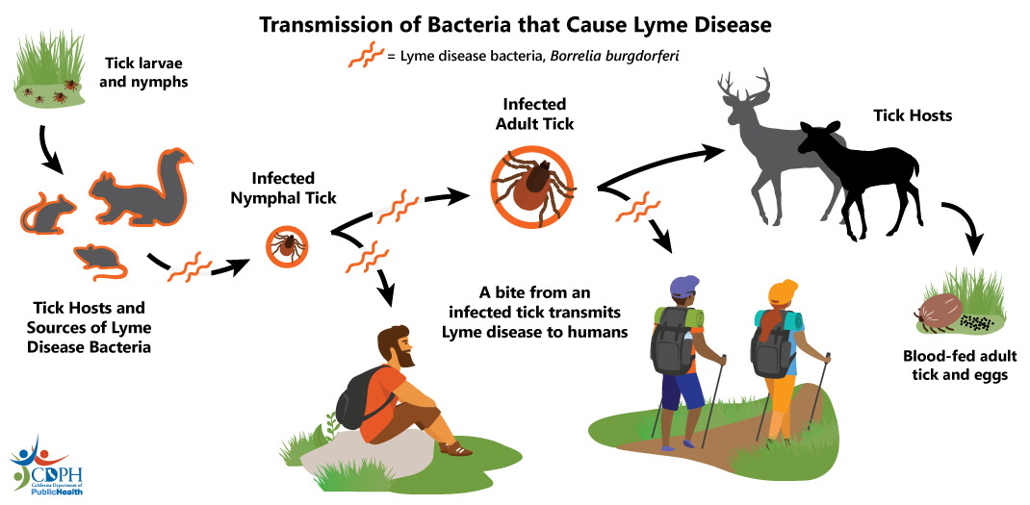
Ticks can become infected with germs (like the germ that causes Lyme disease) when they feed on an infected animal in nature.
Notes:
Supplementary slide – Lyme disease transmission
This slide shows how ticks can get infected with the germs that cause Lyme disease and how ticks can spread these germs to people.
Vocabulary:
Host: What a tick normally feeds on.
Source: Where a pathogen/germ comes from.
Bacteria: Type of germ/pathogen that can make you sick.
Transmission: How a germ/pathogen is passed to a new host/person.

