Slide 1
Directions for this template
Use the Slide Master to make universal changes to the presentation, including inserting your organization’s logo.
“View” tab > “Master” > “Slide Master”
Replace placeholders (indicated by brackets [ ]) with information specific to your Functional Exercise (FE).
Update default date (November 16, 2017) used in slide deck with date specific to your FE.
Delete any slides that are not relevant for your FE.
Delete slide 1 after customizing your slide deck.
Font size should not be smaller than 22 point.
Last revised: 11/28/22

Slide 2
2023 Statewide Medical and Health Exercise
Controller and Evaluator Briefing
2023, [Insert Exercise Location]
Notes:
This briefing is designed to provide you with the information and resources you need to coordinate exercise control and conduct exercise evaluation for the Statewide Medical and Health Exercise for your facility.

Slide 3
Administration
Agenda
Administration
Exercise Overview
General Information
Exercise Logistics
Controller Information and Guidance
Evaluator Evaluation and Guidance
Additional Information (Appendices)

Slide 4
Administration 1
Welcome and Logistics

Slide 5
Administration 2
Welcome
Name
Position
Agency/Organization
Logistics
Meeting materials
Sign-in Sheet
Controller/Evaluator (C/E) Handbook
Follow along in your handbook!
Exercise Evaluation Guides (EEGs)
Master Scenario Events List (MSEL)

Slide 6
Exercise Overview
High Level Summary

Slide 7
Exercise Overview 1
Name
2023 Statewide Medical and Health Exercise
Date
[insert date]
Scope
Mission Areas
[insert selected]
Capabilities
[insert selected]

Slide 8
Exercise Overview (continued)
Objectives
[insert selected]
Threat/hazard
Chemical fire
Scenario
Chemical fire surge
Sponsor
California Department of Public Health (CDPH), Emergency Medical Services Authority (EMSA), [insert your agency/organization]
Participating organizations
[insert]

Slide 9
General Information
Key Material

Slide 10
General Information 1
Introduction
Objectives and Capabilities
Hospital Preparedness Program (HPP) Core Capabilities
[insert agency/organization and core capability details]
Public Health Emergency Preparedness (PHEP) Core Capabilities and Objectives
[insert agency/organization objectives and PHEP capability details]
Health Care Preparedness and Response
[insert agency/organization objectives and Health Care Preparedness and Response capability details]

Slide 11
General Information (continued)
Scenario
Chemical fire surge
Pediatric Surge
Burn Surge

Slide 12
General Information (continued) 1
Participant Roles and Responsibilities
Players
Exercise Director
Safety Controller
Controllers
Senior Controller
Simulators
Evaluators
Actors
Observers
Media Personnel
VIPs
Support Staff

Slide 13
General Information (continued) 2
Assumptions and artificialities
Impacts across response community
Timelines are condensed
See handbook for others
Tools
C/E resources reviewed today
Multiple resources provided via
Homeland Security Exercise and Evaluation Program (HSEEP)
Aligned with HSEEP

Slide 14
Exercise Logistics
Security, Observer Coordination, and More

Slide 15
Exercise Logistics (continued)
Safety
Chemical fire surge policy
Site access
Security
Media/observer coordination
Exercise identification

Slide 16
Exercise Logistics (continued) 1
Parking and transportation
Designated areas
Registration/check-in
Lunch
[insert time and location]
Cleanup and restoration
Supply packaging
Trash supplies
Recycling areas

Slide 17
Post-Exercise & Evaluation Activities
Debriefings, Evaluation and Improvement Planning

Slide 18
Post-Exercise and Evaluation
Debriefings
Hot Wash
Strengths and areas for improvement discussed with the players
Up to 30 minutes
Controller/Evaluator debriefing
Key observations discussed with Controller Evaluators
Participant Feedback Forms
Collect written feedback
Return completed forms to the After Action Report (AAR) lead

Slide 19
Post-Exercise and Evaluation (continued)
Evaluation
Exercise Evaluation Guides (EEG)
Completed by Evaluators
After Action Report (AAR)
Strengths, areas for improvement, and recommendations
Improvement planning
After Action Meeting (AAM)
Reviews draft AAR
Improvement Plan (IP)
Provides due dates and assignments for action items

Slide 20
Participant Information and Guidance
Exercise Rules, Player Instructions and Simulation

Slide 21
Participant Information
Exercise Rules
Real-world emergencies take priority
Start all exercise related communication with “This is an exercise”
Identify the organization or agency you wish to speak with when contacting the Simulation Cell (SimCell)
Keep the exercise objectives in mind throughout the exercise
[insert others as needed]

Slide 22
Participant Information (continued)
Player Instructions
Before the exercise
Review Player Handout and other exercise materials
Players should arrive at the exercise site 30 minutes in advance
[insert others as needed]
During the exercise
Respond as though real
Obtain information through emergency channels
[insert others as needed]

Slide 23
Participant Information (continued) 1
Player Instructions
After the exercise
Participate in Hot Wash
Complete Feedback Form
[insert others as needed]
Simulation Guidelines
Based on Master Scenario Events List (MSEL)

Slide 24
Controller Information And Guidance
Overview, Instructions and More

Slide 25
Controller Information
Exercise control documentation
Controller package
Incident simulation
Scenario tools
Master Scenario
Events List (MSEL)

Slide 26
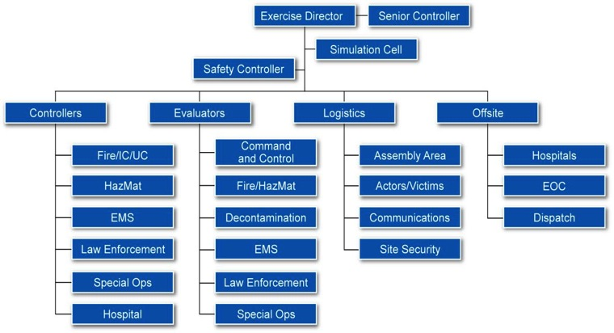
Controller Information (continued)
Exercise Control Structure

Slide 27
Controller Information (continued) 1
Controller instructions
Before the exercise
Review materials
Attend briefings
[inserts others as needed]

Slide 28
Controller Information (continued) 2
During the exercise
Wear identification
Avoid personal conversations
Deliver injects at the time indicated on the MSEL or as directed by Exercise Director
Avoid prompting or providing extra or advance information to players
Note all key actions and the time they occur
Receive and record information from players that would be directed to non-participating groups
Ensure observers and/or media stay out of exercise play area
[insert others as needed]

Slide 29
Controller Information (continued) 3
Exercise controller maintains exercise scope, pace, and integrity during exercise conduct.
Controller instructions
After the exercise
Distribute Participant Feedback Forms
Conduct Hot Wash
[inserts others as needed]
Chemical fire surge tools
MSEL

Slide 30
Controller Information (continued) 4
Controller responsibilities
After the Exercise
Controller/Evaluator Debriefing
Placement and monitoring
Post-exercise activities
Exercise report
AAR feedback
After Action Meeting

Slide 31
Evaluator Information and Guidance
Overview, Instructions and More

Slide 32
Evaluator Information
General information
Assess the organization’s ability to accomplish a mission, function, or objective
Exercise evaluation
HSEEP AAR/IP
EEGs
Tool for identifying and analyzing key events

Slide 33
Evaluator Information (continued)
Exercise evaluation validates strengths and identifies areas for improvement.
Evaluator instructions
Before the exercise
Review materials
Be familiar with the plans, policies, and procedures
Attend briefings
[inserts others as needed]

Slide 34
Evaluator Information (continued) 1
During the exercise
Wear identification
Stay near decision makers
Use EEGs to document performance relative to exercise objectives, capabilities, and tasks
Document performance
Avoid providing extra information or interfering in player actions
[insert others as needed]

Slide 35
Evaluator Information (continued) 2
Evaluator instructions
After the exercise
Participate in Hot Wash
Turn in EEGs to Lead Evaluator
Report exercise outcomes in the AAR
[inserts others as needed]

Slide 36
Evaluator Information (continued) 3
Using the Exercise Evaluation Guides
[P - Performed without Challenges]
[S - Performed with Some Challenges]
[M - Performed with Major Challenges]
[U - Unable to be Performed]
Tips and focus areas
Activities and key decisions that relate to goals and objectives
Expected actions associated with injects
Critical events or initiating chemical fire surge events
Deviation from plans or procedures
Judge the plans, capabilities, and actions, NOT the players

Slide 37
Evaluator Information (continued) 4
Assessment, review, and analysis of exercise
Evaluator package
Controller/Evaluator debriefing
Placement and monitoring
Post-exercise activities
Hot Wash
C/E debrief
Evaluations
Participant Feedback Forms
After Action Report

Slide 38
Action Items
Questions and More

Slide 39
Action Items 1
Review all materials
Ask questions
Report to exercise check-in

