Slide 1
DIRECTIONS FOR THIS TEMPLATE
Use the Slide Master to make universal changes to the presentation, including inserting your organization’s logo.
  “View” tab > “Master” > “Slide Master”
Replace placeholders (indicated by brackets [ ]) with information specific to your exercise.
Update default date (exercise date) used in slide deck with date specific to your exercise.
Delete any slides that are not relevant.
Delete slide 1 after customizing your slide deck.
Font size should not be smaller than 22 point.
Last revised: 3/20/18

Slide 2
[INSERT YEAR] STATEWIDE MEDICAL AND HEALTH EXERCISE
PLAYER DEBRIEF
[Exercise Date, Exercise Location]

Slide 3
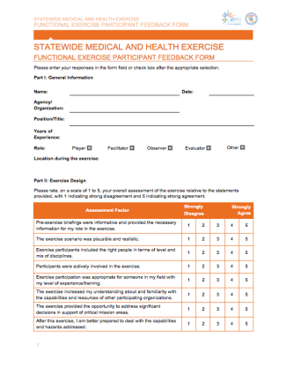
ADMINISTRATION
ADMINISTRATION
Sign-In
Introductions
  Name and role in exercise
Materials
  Participant Feedback Form

Slide 4






SWMHE EXERCISE DEBRIEF OVERVIEW
SWMHE EXERCISE DEBRIEF OVERVIEW
1. PURPOSE OF
TODAY’S EXERCISE
4. OUTCOME:
STRENGTHS
2. OBJECTIVES
5. OUTCOME: AREAS
FOR IMPROVEMENT
3. EXPECTATIONS
6. CONCLUSION

Slide 5

PURPOSE OF TODAY’S EXERCISE
[INSERT YEAR] SWMHE EXERCISE DEBRIEF

Slide 6
PURPOSE OF TODAY’S EXERCISE
PURPOSE OF TODAY’S EXERCISE
The purpose of this exercise was to evaluate role-player actions/decisions within current response plans and capabilities in the context of a potential [insert incident] response.

Slide 7
OBJECTIVES
[INSERT YEAR] SWMHE EXERCISE DEBRIEF

Slide 8
OBJECTIVES AND CORE CAPABILITIES
OBJECTIVES AND CORE CAPABILITIES
[Insert Objective 1]
  - [Linked Public Health Emergency Preparedness (PHEP) / Health Care Preparedness and Response / Federal Emergency Management Agency (FEMA) Core Capabilities]
[Insert Objective 2]
  - [Linked PHEP / Health Care Preparedness and Response / FEMA Core Capabilities]
[Insert Objective 3]
  - [Linked PHEP / Health Care Preparedness and Response / FEMA Core Capabilities]

Slide 9
EXPECTATIONS
[INSERT YEAR] SWMHE EXERCISE DEBRIEF

Slide 10
OUTCOME: STRENGTHS
[INSERT YEAR] SWMHE EXERCISE DEBRIEF

Slide 11
OUTCOME: AREAS FOR IMPROVEMENT
[INSERT YEAR] SWMHE EXERCISE DEBRIEF

Slide 12

CONCLUSION
[INSERT YEAR] SWMHE EXERCISE DEBRIEF

Slide 13
CONCLUSION
CONCLUSION
Thank you for your
participation and feedback!
Please turn in any forms, including:
  Completed Participant Feedback Forms
  Player Logs and Notes
Please return any equipment you received/borrowed
Please return your badges and vests
[Insert any additional concluding information]

Slide 14
[INSERT YEAR] STATEWIDE MEDICAL AND HEALTH EXERCISE
SWMHE EXERCISE DEBRIEF
[Exercise Date, Exercise Location]

